Slide 1
Jokers
Created by Daniel Murtagh,
Ryan Rogers,
& Christian Moncada

Slide 2
Introduction
Daniel, Ryan and Christian are seniors in the School of Computer Science & Engineering @ Sacred Heart University
Daniel is a Game Design major, Ryan is a Computer Science major, and Christian is an IT major
For our Capstone Project, we have decided to create a PC-based card game based on the popular casino game Blackjack
Our game is called Jokers!

Slide 3
What is Jokers?
Jokers is a Blackjack-based casino game where you play as the dealer, rather than a player
You have control over the cards in the deck and can decide who gets what card!
You do this through a variety of card shuffling mechanics and by dealing select cards in the deck
Your objective is to make sure the other players bust or for you, the dealer to get the closest-to or exactly 21
And to make sure the casino turns a profit by day’s end…

Slide 4
What makes this game unique?
Use of AI to make player bots play to win and increase difficulty as more rounds are won
Multiple card shuffling mechanics, simulating that of an actual casino dealer
A new user interface than that of a traditional virtual card games
Provides a different and strategic way of learning and playing Blackjack

Slide 5
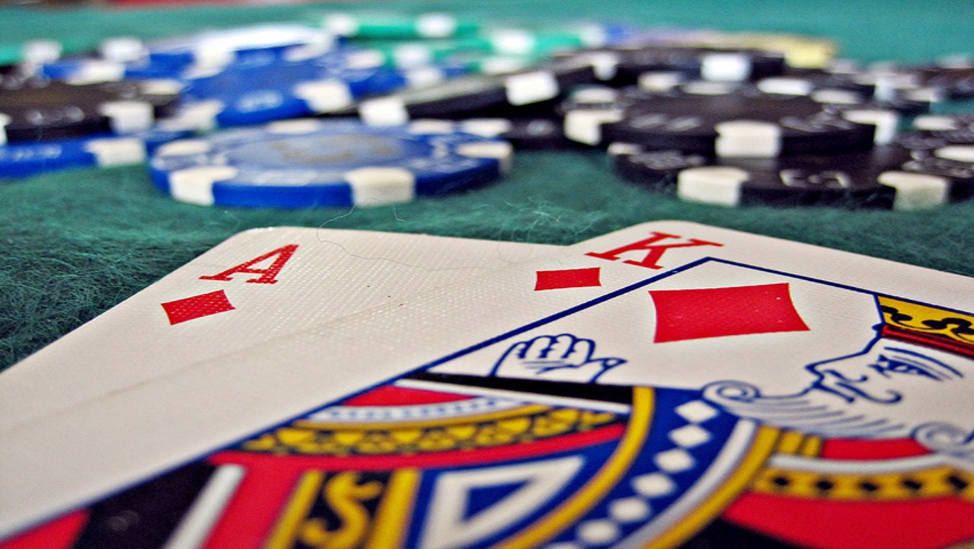
The Story
You are a card dealer working at a lousy casino called the Joker’s Casino on the strip in beautiful Las Vegas, Nevada
Unfortunately, you are struggling to make ends meet for your family and your Bulgarian stripper wife (Yikes!)
The only way for you and the casino to make some money is to cheat your patrons in a good ol’ game of Blackjack…

Slide 6
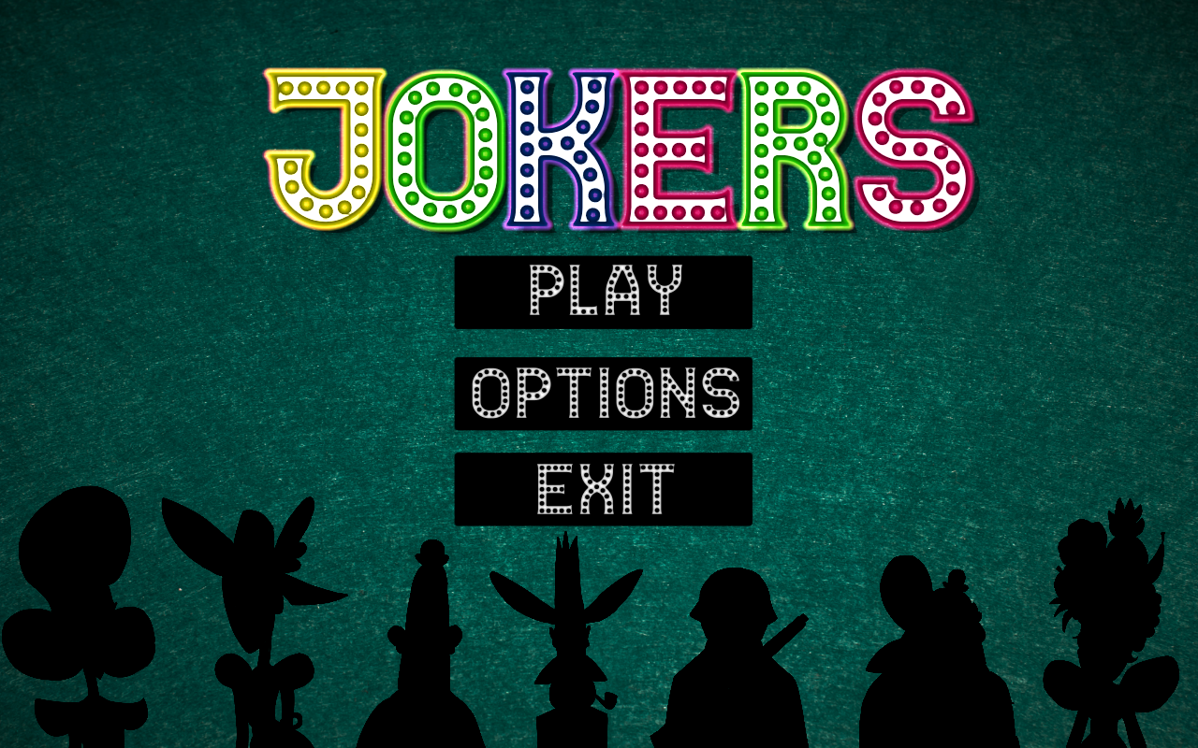
Artwork and Gameplay Visuals

Slide 7

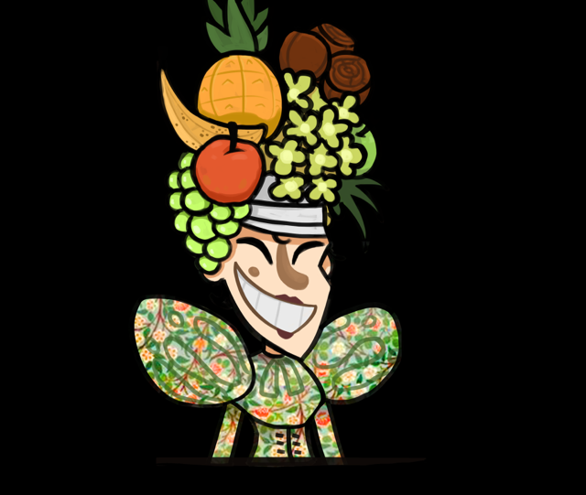
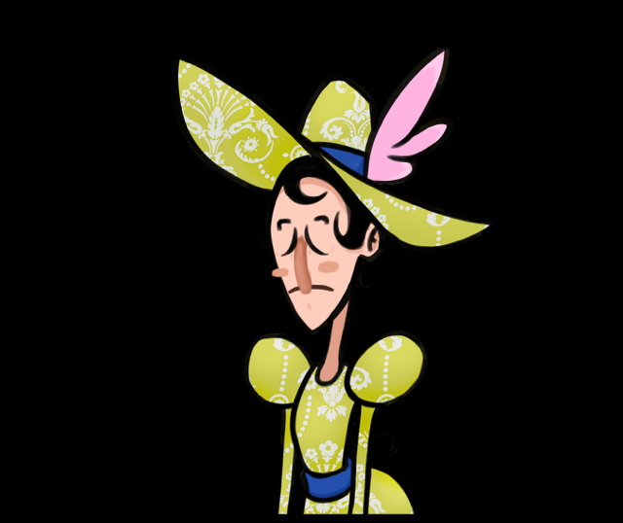




Slide 8
Gameplay Testing Results
The initial round of testing consisted of 10 random people playing through one round of the game
At the time of initial testing, the card shuffling mechanics were ready and most of the user interface
Missing from initial testing was:
Marked Card Mechanics
Settings Screen
Functioning Exit button
Multiple rounds
Winnings-per-day counter

Slide 9
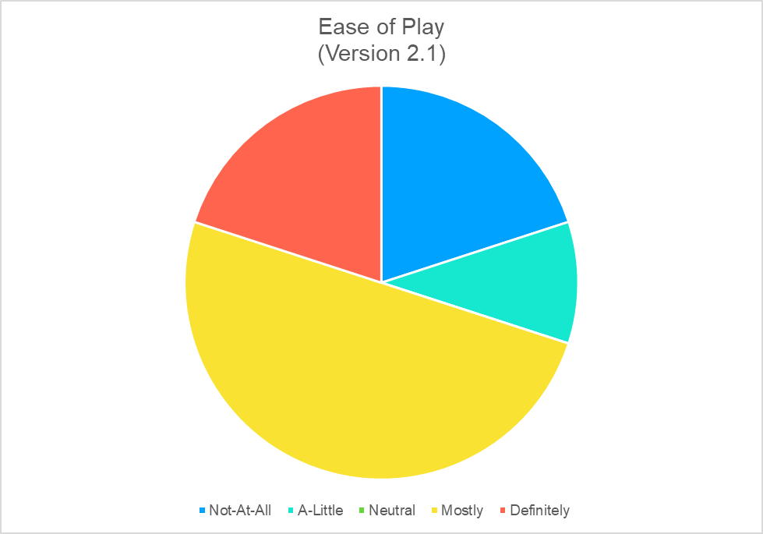
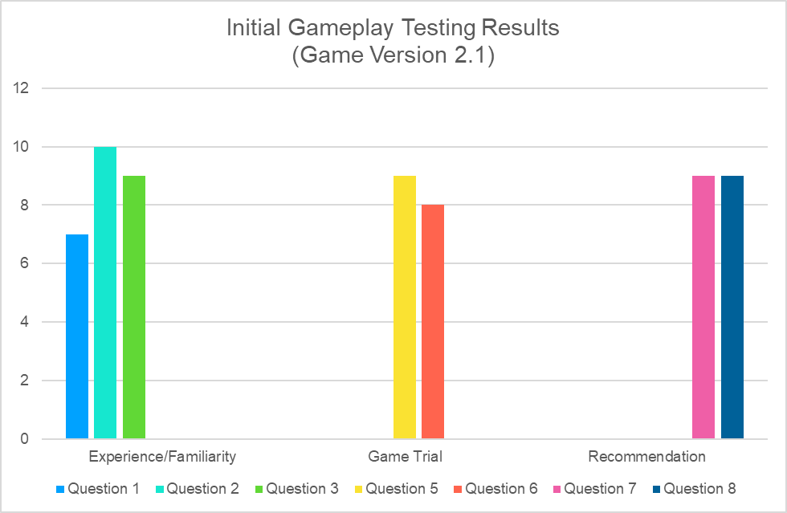

Slide 10
Gameplay Testing Results
The 2nd round of testing consisted of another 10 random people playing through one round of the game
At the time of 2nd round testing there was an update to the UI, multiple round counter and winnings-per-day counter, Settings Screen, and functioning Exit button
Additional questions were added to the game survey addressing the changes to the game
Missing from 2nd round testing was:
Marked Card Mechanics

Slide 11
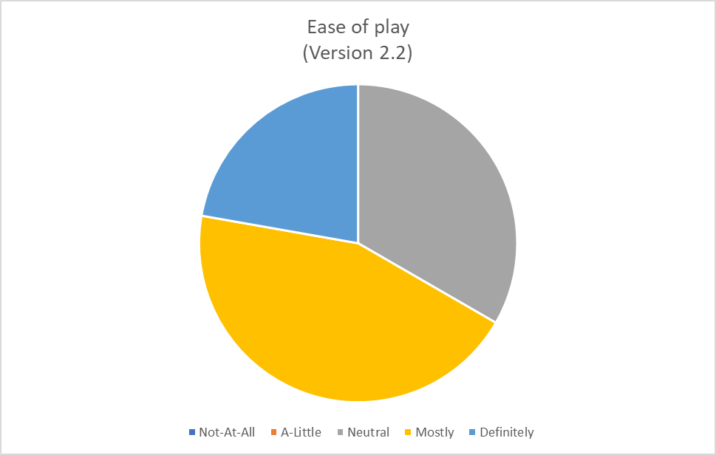
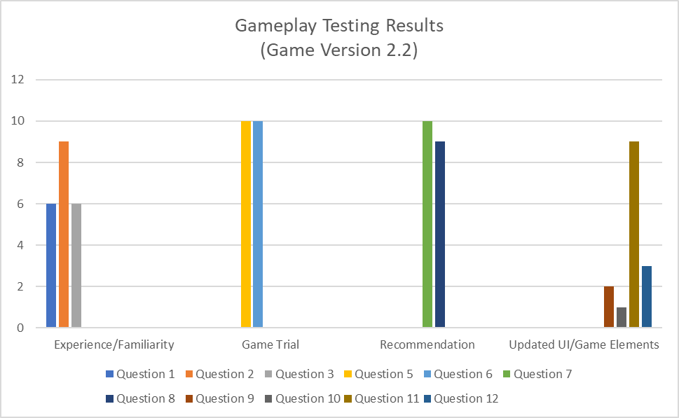

Slide 12
Gameplay Testing Results
The 3rd Round testing consisted of another 10 random trials with a questionnaire at the end consisting of 10 questions
During this round of testing, the UI was changed in terms of font, button placement, and background image
As well as an added difficulty option, to add an element of challenge
It was decided that the Marked Card mechanic would not be included in the final version

Slide 13
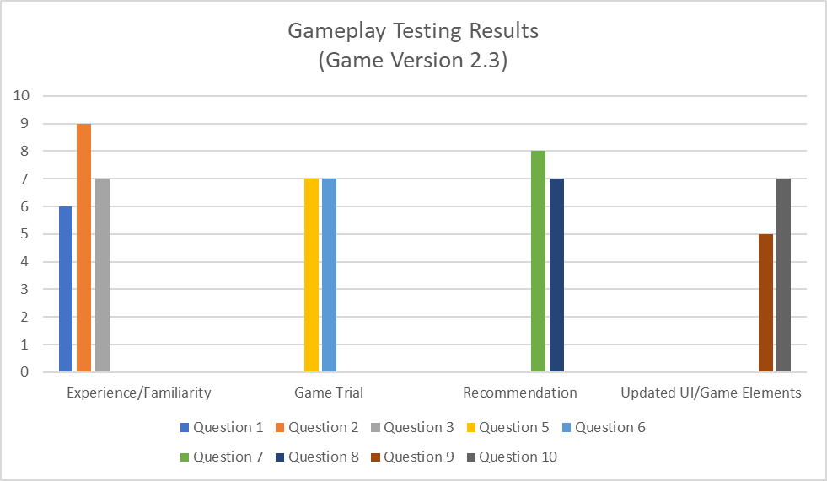
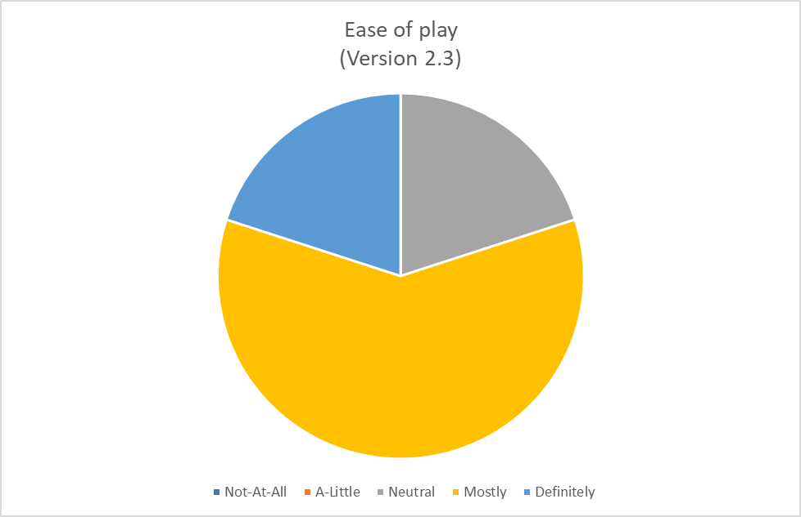

Slide 14
AI

Slide 15
AI

Slide 16
Game Mechanics

Slide 17
Game Mechanics

Slide 18
UI

Slide 19
UI

Slide 20
UI

